Slide 1
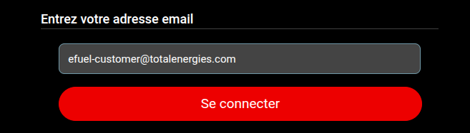
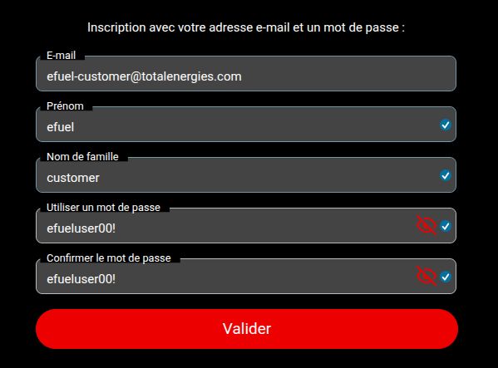
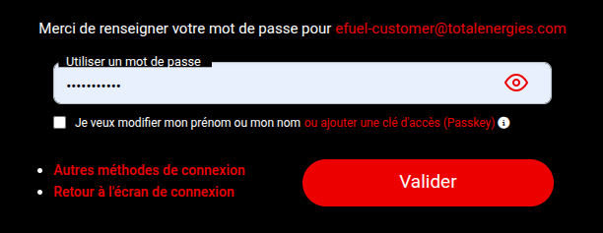
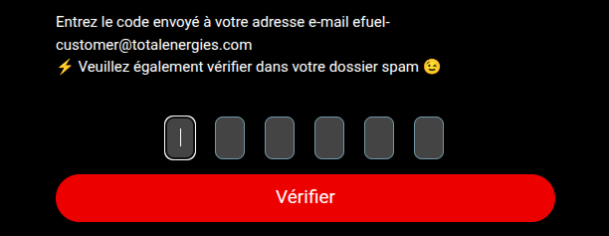
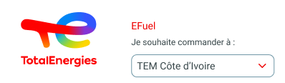
eFuel
First connection to the platform
1
In order to connect to the platform, you must enter the email with which you wish to connect on TE CONNECT and click on connect
2.a
2.b
If the email entered does not correspond to an existing account in TE connect, then you must fill out an account creation form and click on Validate and enter the code received by email
If the entered email corresponds to an existing account in TE connect then you must enter your password and click on Validate
3
To access the products, you must select a subsidiary for which you wish to order from the selector at the top in the header
1

Slide 2
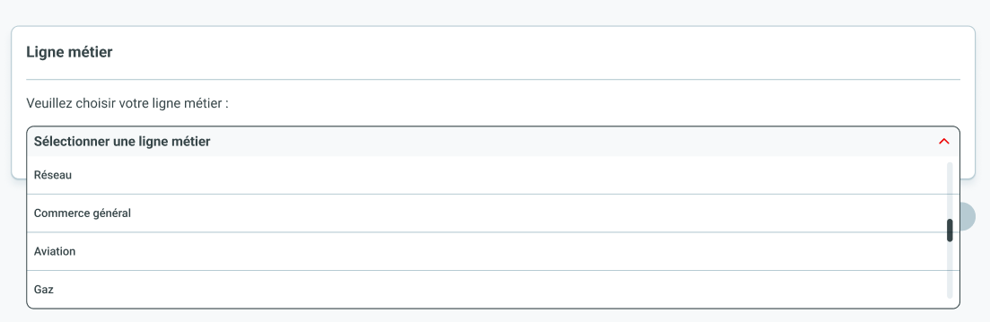
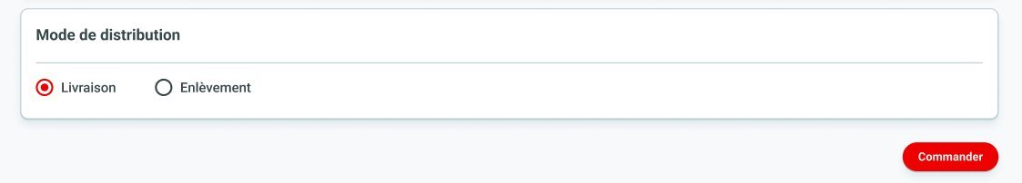
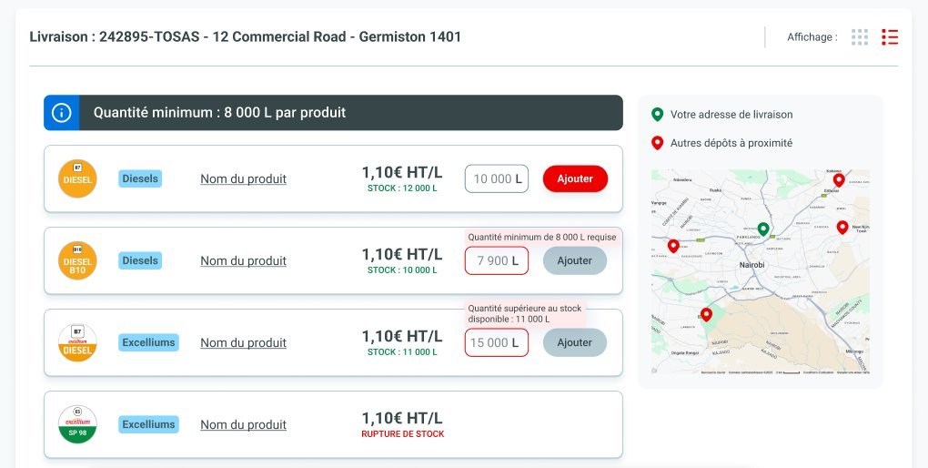
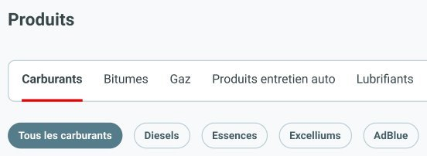
eFuel
II. Purchase journey order delivered
1
To access the products for a delivered order, you must first select a business line in the selector
2
Once the business line is selected, you must choose your distribution method and click on validate in order to view the products
4
You can view in blocks the delivery points attached to the customer accounts for which you can place an order with its associated products and geolocation
3
You can view in tab form the list of business sectors to which you have access for the previously selected subsidiary and business line combination with tags corresponding to the divisions
2

Slide 3
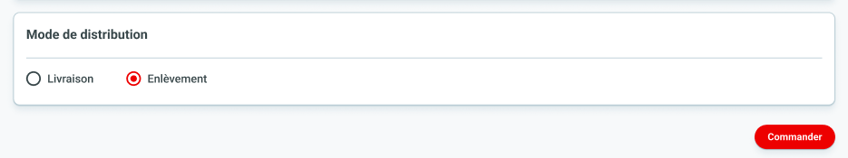
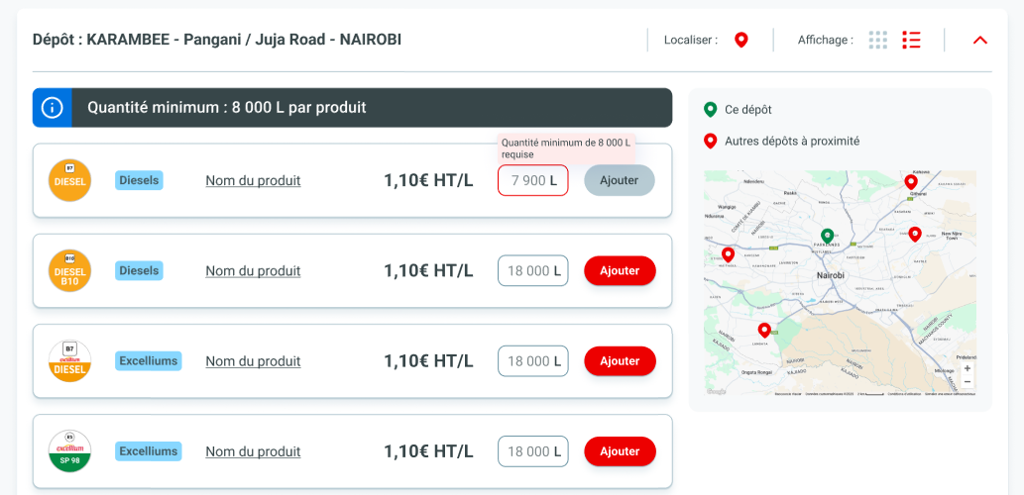
eFuel
II. Purchase journey order pickup
1
To access the products for a pickup order, you must first select a business line in the selector
2
Once the business line is selected, you must choose your distribution method and click on validate in order to view the products
4
You can see in blocks the deposits attached to the sectors of activity for which you can place an order with its associated products and geolocation
3
You can view in tab form the list of business sectors to which you have access for the previously selected subsidiary and business line combination with tags corresponding to the divisions
3

Slide 4
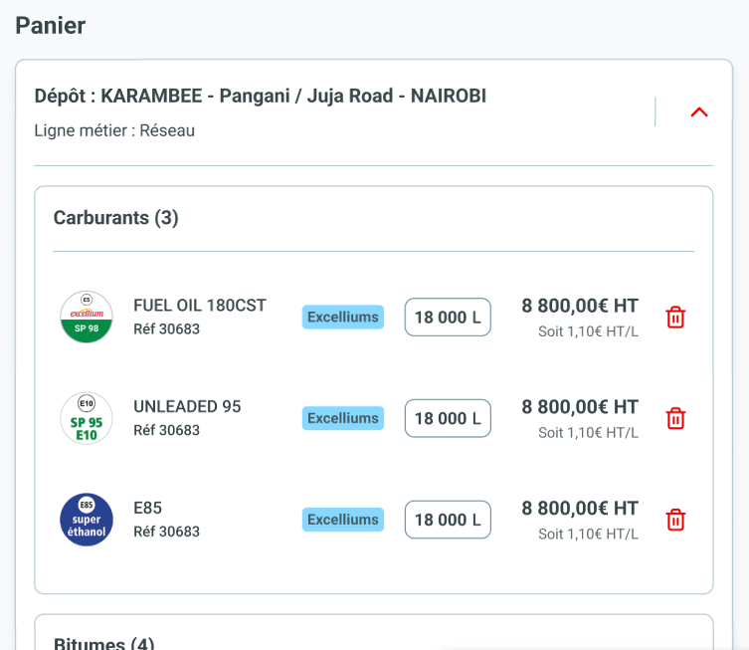
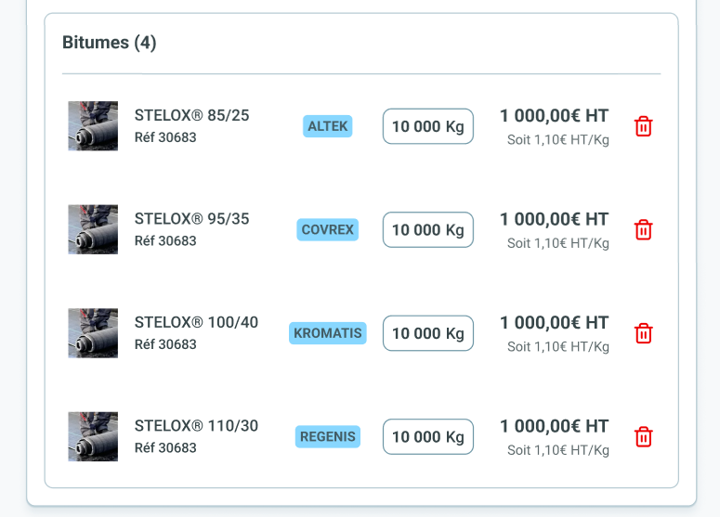


eFuel
III. Order cart delivery – Step cart
1
By clicking on the cart icon you are redirected to the order basket containing the list of products added to the basket for the business line and the selected sectors of activity whose quantity you can modify and their presence in the basket
2.a
To validate the basket and access the step of filling out the distribution terms, simply click on the finalize my order button
2.b
To continue adding products to the cart, simply click on the continue shopping button
4

Slide 5
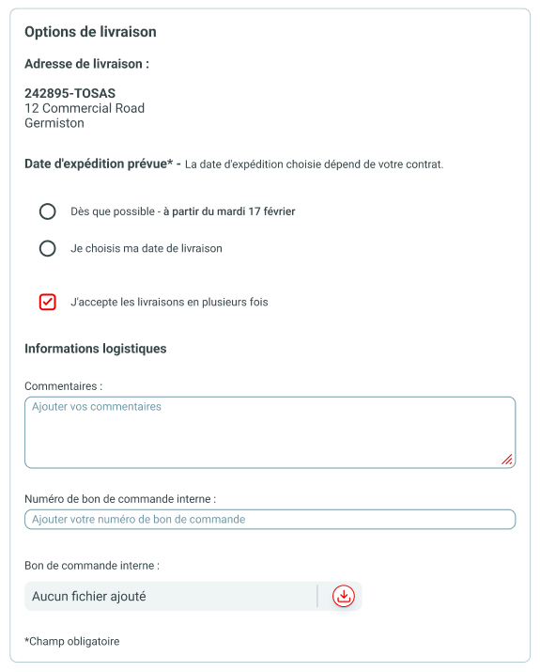
eFuel
III. Order cart delivery – Step distribution config
Delivery address informations
Desired delivery date
Can the delivery be done in several times or not
Comment for delivery if needed
Internal order number if needed
Internal order file if needed
5

Slide 6
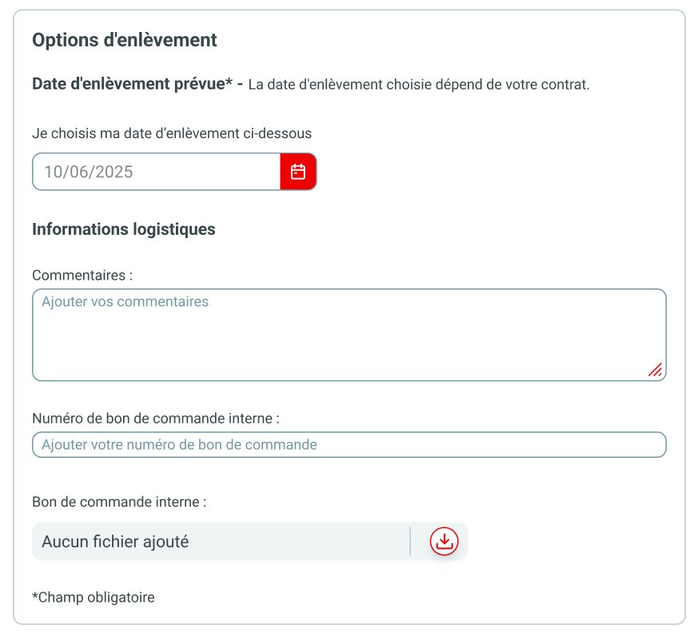
eFuel
III. Purchase journey order pickup
Desired pickup date of the order at the depot
Comment for delivery if needed
Internal order number if needed
Internal order file if needed
6

Slide 7
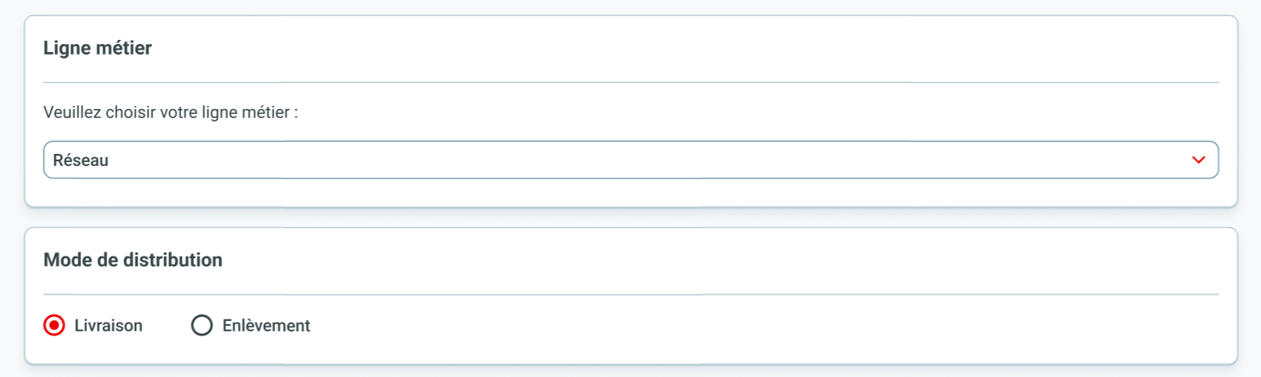
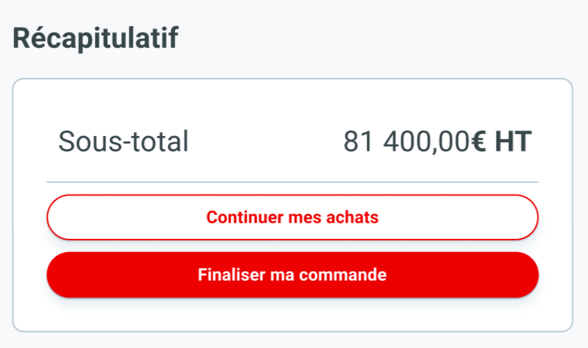
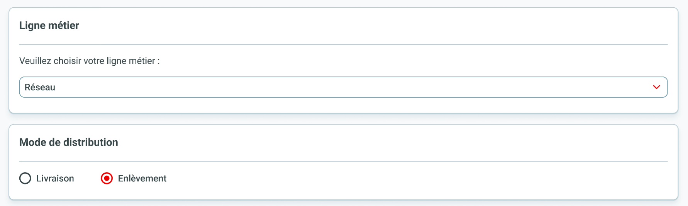
eFuel
III. Order cart delivery – Distribution confirmation
1.a
By clicking on the continue my purchases button you are redirected to the configuration of the business line and the delivery method (but keeping in mind the one previously chosen that you can change id needed)
1.b
By clicking on the finalize my order button, your order is sent to SAP
and you can access your order summary
7

Slide 8
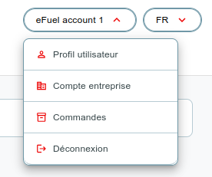
eFuel
IV. Customer navigation
User profile to view and edit your profile information
Business account allowing to view and edit information related to your company
List of your orders placed with this account, allowing you to view past orders and access their details
Logout button allowing you to disconnect from the platform
8

